Slide 1
Lab 4: Keypad Scanning
ECE 2020

Slide 2
Lab Outline
Download assembly template project from courseweb (keep LCD files!)
Enable peripheral GPIO pins (4 output, 4 input)
Write logic to determine which button is pressed
Write that character to the internal LCD
Show us the working keypad (checkoff)
Show us that debouncing is implemented (checkoff)
Submit code (e.g. ‘main.s’) on courseweb
Submit pre-lab and post-lab questions on courseweb

Slide 3
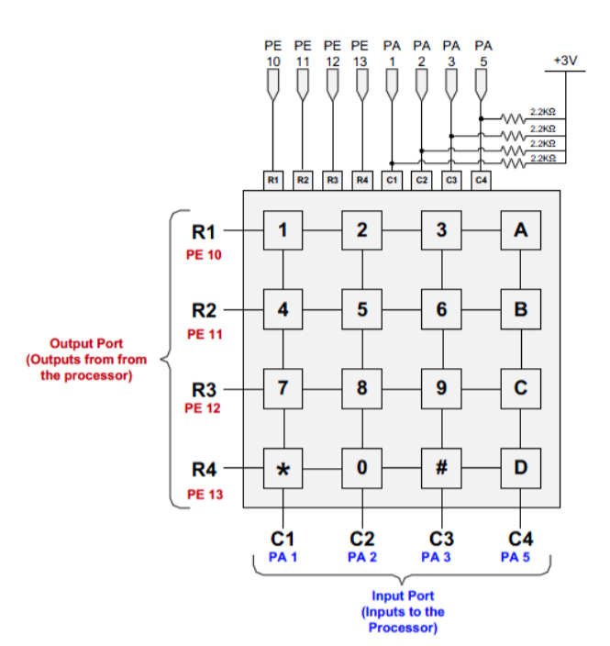


The Circuit
Our output pins drag down the voltage of our input pins when a button is pressed
We need external pull-up resistors for our input pins
Not mandatory, but can configure the output pins to open-drain instead of push pull to prevent short circuit
PA1
PE10
1

Slide 4
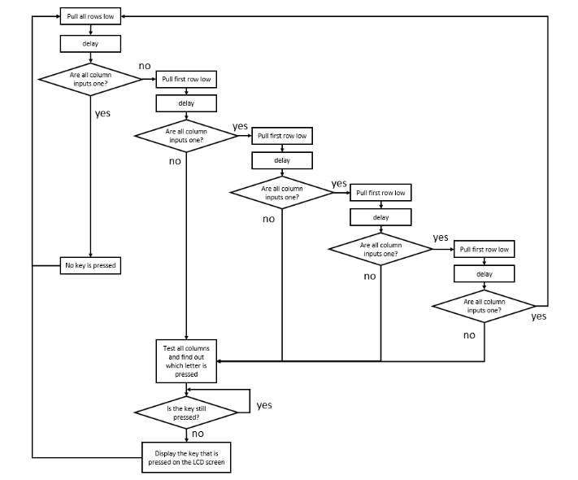
Writing the Logic
Every “split” of the flowchart should be a conditional statement
Idea is to find the row of the pressed button first, then the column

Slide 5
Delays/Software Debouncing
Delay 1: needed in between each change of the output pins (primarily due to capacitors on the input pins)
...also provide debouncing (trace flowchart)
Delay 2: once the button is pressed, wait until it is not pressed anymore

Slide 6

Writing to LCD
Using the help of a function in LCD.c, which makes our life easy!
Store your character to the string variable
Load the string address into R0
Branch to LCD_DisplayString

